Slide 1
Speaking Module For Deaf & Dumb

Slide 2
INTRODUCTION
About nine thousand million people in the world are deaf and dumb. The communication between a deaf and normal person is to be a serious problem compared to communication between blind and normal visual people. Sign language is a non-verbal form of intercommunication which is found amongst deaf people in world and is a more organized and defined way of communication in which every word or alphabet is assigned some gesture. The languages do not have a common origin and hence difficult to translate. A gesture in a sign language is a particular movement of the hands with a various shape made out of fingers. A gesture on the other hand, is a static shape of the hand orientation to show a sign. Gesture recognition is categorized into two main groups i.e. vision based and sensor based. The sensor based technique offers better mobility.

Slide 3
My Objective
The main aim of this project is to present a system that can efficiently interpret Sign Language gestures to both text and auditory speech. I have focused on designing a Human Computer Interface (HCI) system that can understand the sign language accurately so that the signing people may communicate with the non signing people without the need of an interpreter. It can be used to generate speech or text. The converter here makes use of a glove based technique consisting of flex sensors. The device translates alphabets as Ill as can form words using specific gestures made by the person .

Slide 4
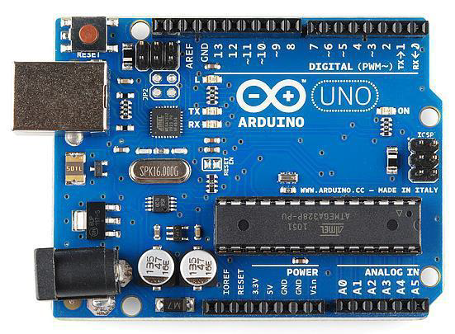
PRODUCT SPECIFICATIONS
Arduino UNO
Arduino/Genuino Uno is a microcontroller board based on the ATmega328P. It has 14 digital input/output pins (of which 6 can be used as PWM outputs), 6 analog inputs, a 16 MHz quartz crystal, a USB connection, a power jack, an ICSP header and a reset button.
It contains everything needed to support the microcontroller; simply connect it to a computer with a USB cable or power it with a AC-to-DC adapter or battery to get started. The ATmega328 has memory of 32 KB (with 0.5 KB occupied by the boot loader). It also has 2 KB of SRAM and 1 KB of EEPROM. The Arduino programming language is a simplified version of C/C++.

Slide 5
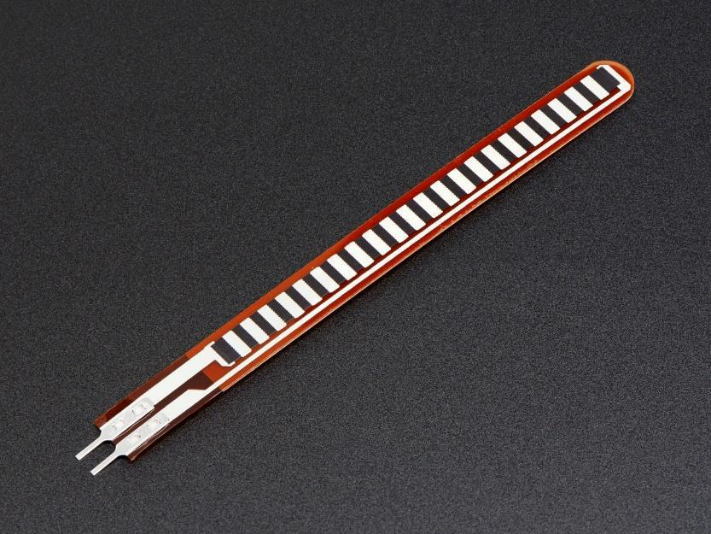
2. Flex Sensor
Flex sensors are sensors that change in resistance depending how much the sensor is bend. Sensors convert the change in bend to electrical resistance - the more the sensor bend, the higher the resistance value. Using the Flex Sensor is very easy. There are couple of different manufacturers in the market. Datasheet instructs you to use operational amplifier (op-amps).

Slide 6
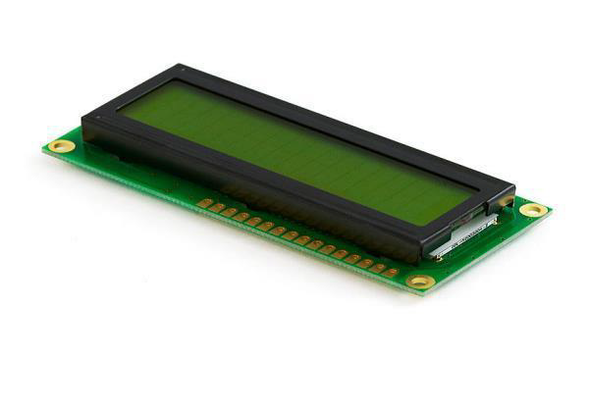
3. Liquid Crystal Display (LCD)
The output of the system is displayed on LCD. In My system16x2 LCD is used. The 16x2 indicates 16 columns and 2 rows. So, I can write 16 characters in each line. So, total 32 characters I can display on 16x2 LCD. The LCD will display the word corresponding to each hand gesture made by user. This enables the mute people to convey their thoughts using words. And also helps deaf people to understand what is conveyed the person communicating with them. As deaf people can read the words directly from the LCD. Hence this system enables deaf people to communicate with Mute as well as normal people.

Slide 7
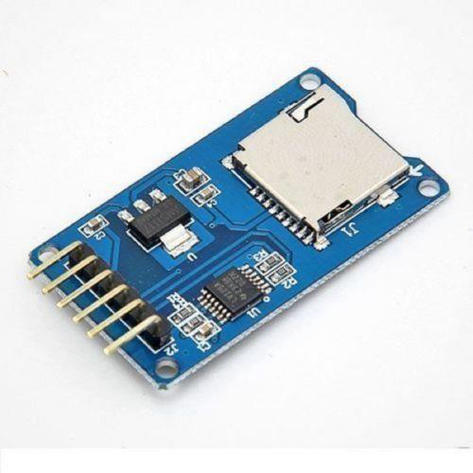
4. SD Card Module
The purpose of using SD Card in this system is to store the data. In My system the 32 GB SD card is used. The SD card stores the .wav file corresponding to each word. This data used to play the output of the system on Loud Speaker and display it on the LCD screen..

Slide 8
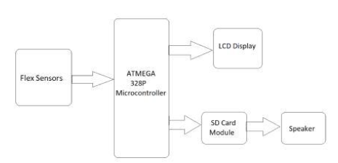
IMPLEMENTATION AND CONSTRUCTION

Slide 9
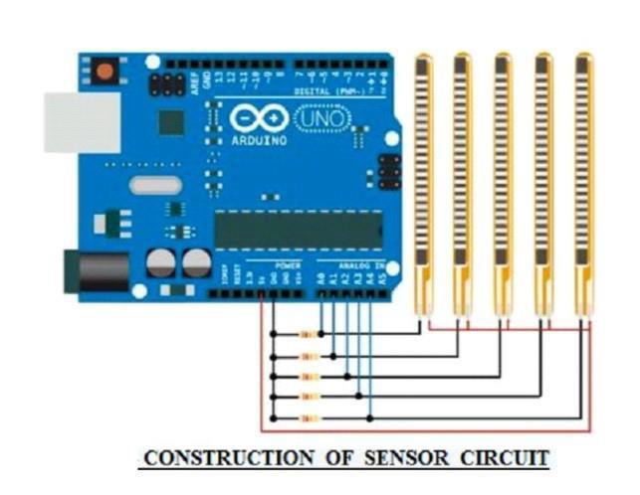
1.SET UP THE CIRCUIT

Slide 10
Procedure
The flex sensors require a circuit in order for them to be compatible with Arduino. It's a voltage divider: the flex sensors are variable resistors, and when paired with resistors of a static value, change in resistance (in this case bending the sensor) can be sensed through the change in voltage between the resistors. This can be measured by the Arduino through its analog inputs.
The schematic is attached (red is positive voltage, black is negative, and blue goes to the Arduino). The resistors in the photo are 10K.
The main GND wire, which is connected to all the individual GND wires from the sensors, gets plugged into the Arduino's GND. The positive end of each of the Flex sensor is connected to one end of the potentiometer which is used to control the voltage provided by the sensors.

Slide 11
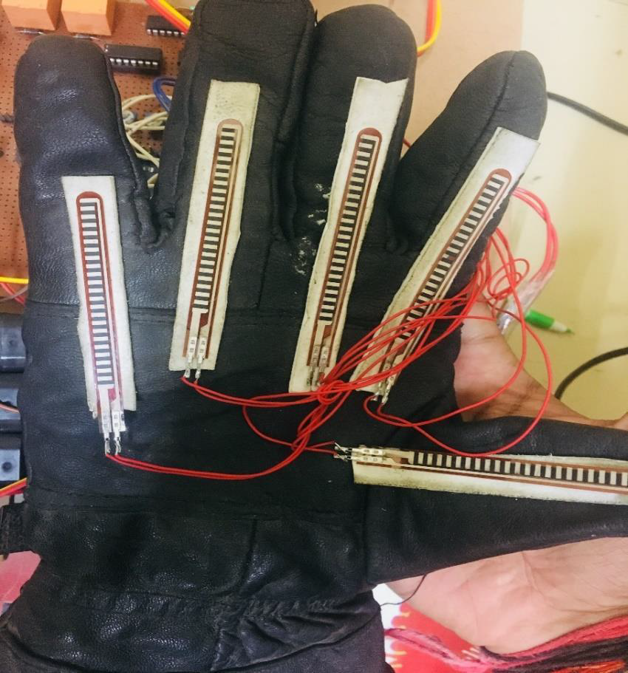
Flex Sensor Mounting
Now it's time to mount the sensors and their circuit onto the glove itself. On each finger, with a pencil or pen, I made small lines over the tops of each joint/knuckle placed on the inside rather than outside and pasted them on the glove using Double sided Tape.

Slide 12
Working
Physical form of the circuit is shown in figure below. I consist of microcontroller interfaced flex sensors, voice module, etc. Change in the values of flex sensors gives some hex code to the microcontroller which after compilation displays the output in LCD and also produces the voice through the speaker. The words or signs are obtained by taking English as a reference. For every word, values of flex sensors are compared with the values already saved in the microcontroller and then the result is displayed in LCD.
Flex sensor and microcontroller are used in this system to capture the words. The work of flex sensor is to obtain changed position of fingers and to capture words. By changing the position of hands the values of flex sensor will not get changed because flex sensor is placed in fingers. Sign language used by deaf and dumb people will be using fingers or hands in marked position and rotating hands or fingers. To analyze these positions of fingers or hand microcontroller is used. This microcontroller is placed on the device so that by changing the finger for conversation, flex sensor and microcontroller values will get changed, by comparing these two values, output is displayed in display and voice module gives the voice output.

Slide 13
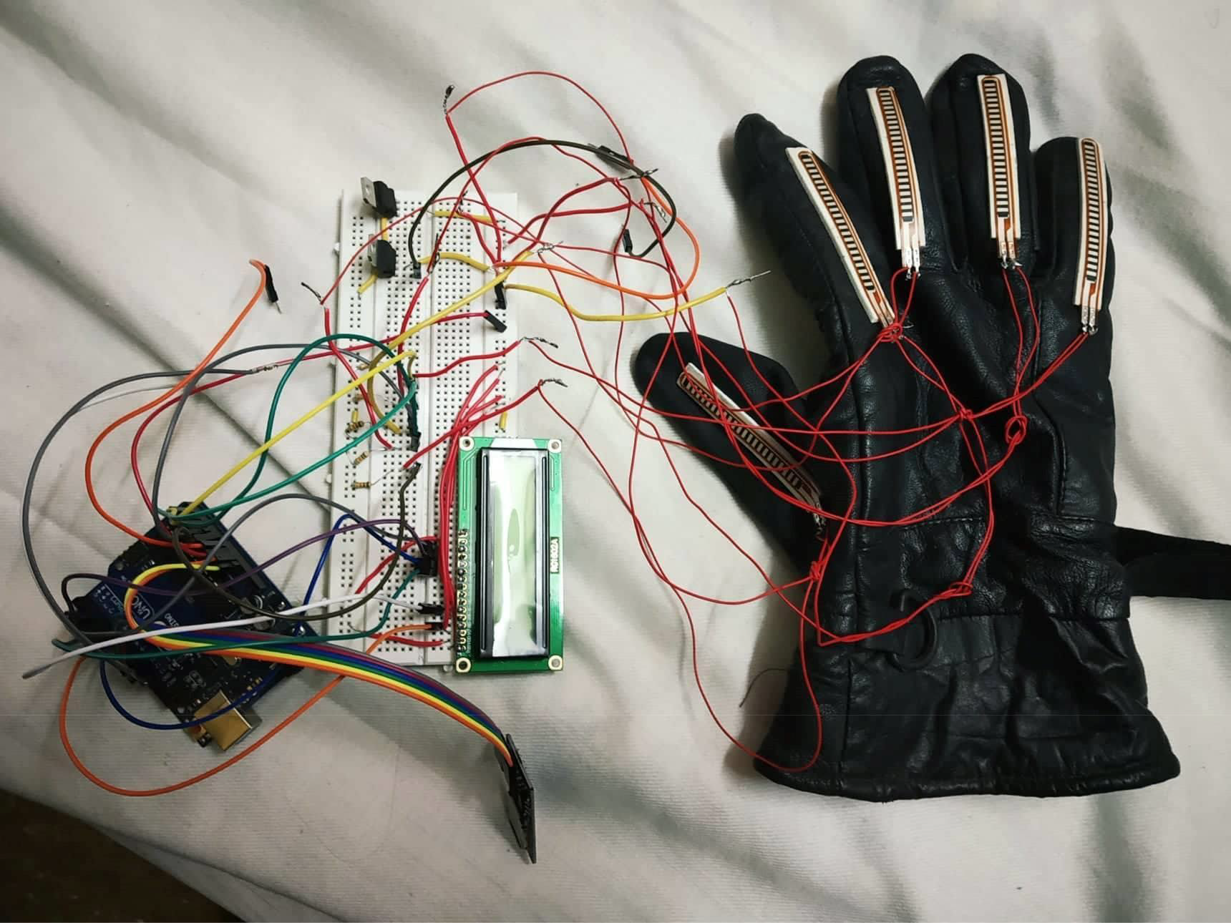

Slide 14
Conclusion
Sign language may be a helpful appliance to ease the communication between the deaf or mute community and additionally the standard people. This project aims to lower the communication gap between the mute community and additionally the standard world. The projected methodology interprets language into speech. The system overcomes the necessary time difficulties of dumb people and improves their manner. Compared with existing system the projected arrangement is compact and is possible to carry to any places. This system converts the language in associate passing voice that's Ill explicable by blind and ancient people. The language interprets into some text kind displayed on the digital display screen, to facilitate the deaf people likewise. In world applications, this system is helpful for deaf and dumb of us those cannot communicate with ancient person. The foremost characteristic of this project is that the gesture recognizer may be a standalone system, that's applied in commonplace of living. It’s in addition useful for speech impaired and paralyzed patient means those do not speak properly and in addition used for Intelligent Home Applications and industrial applications.

